Slide 1
AGILE DEVELOPMENT and 49x

Slide 2
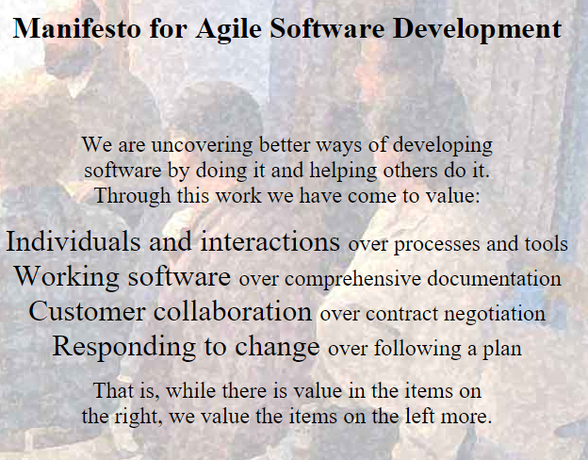

Slide 3
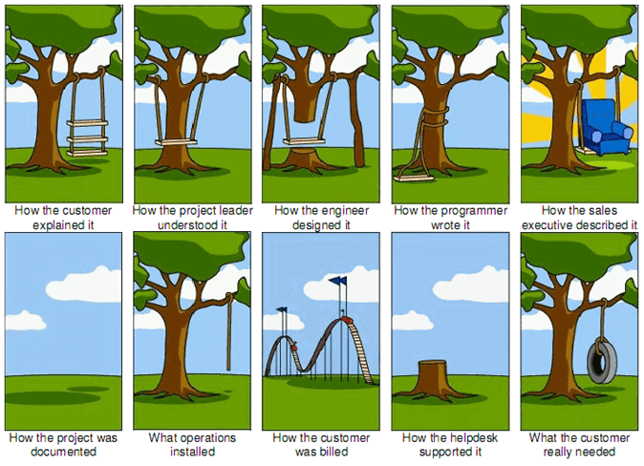
Agile principles
Incremental delivery
Customer involvement
Embrace the change
Maintain simplicity
People not process

Slide 4
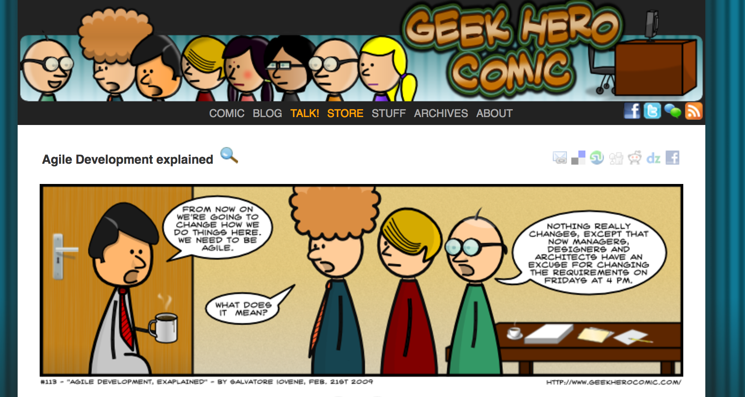

Slide 5
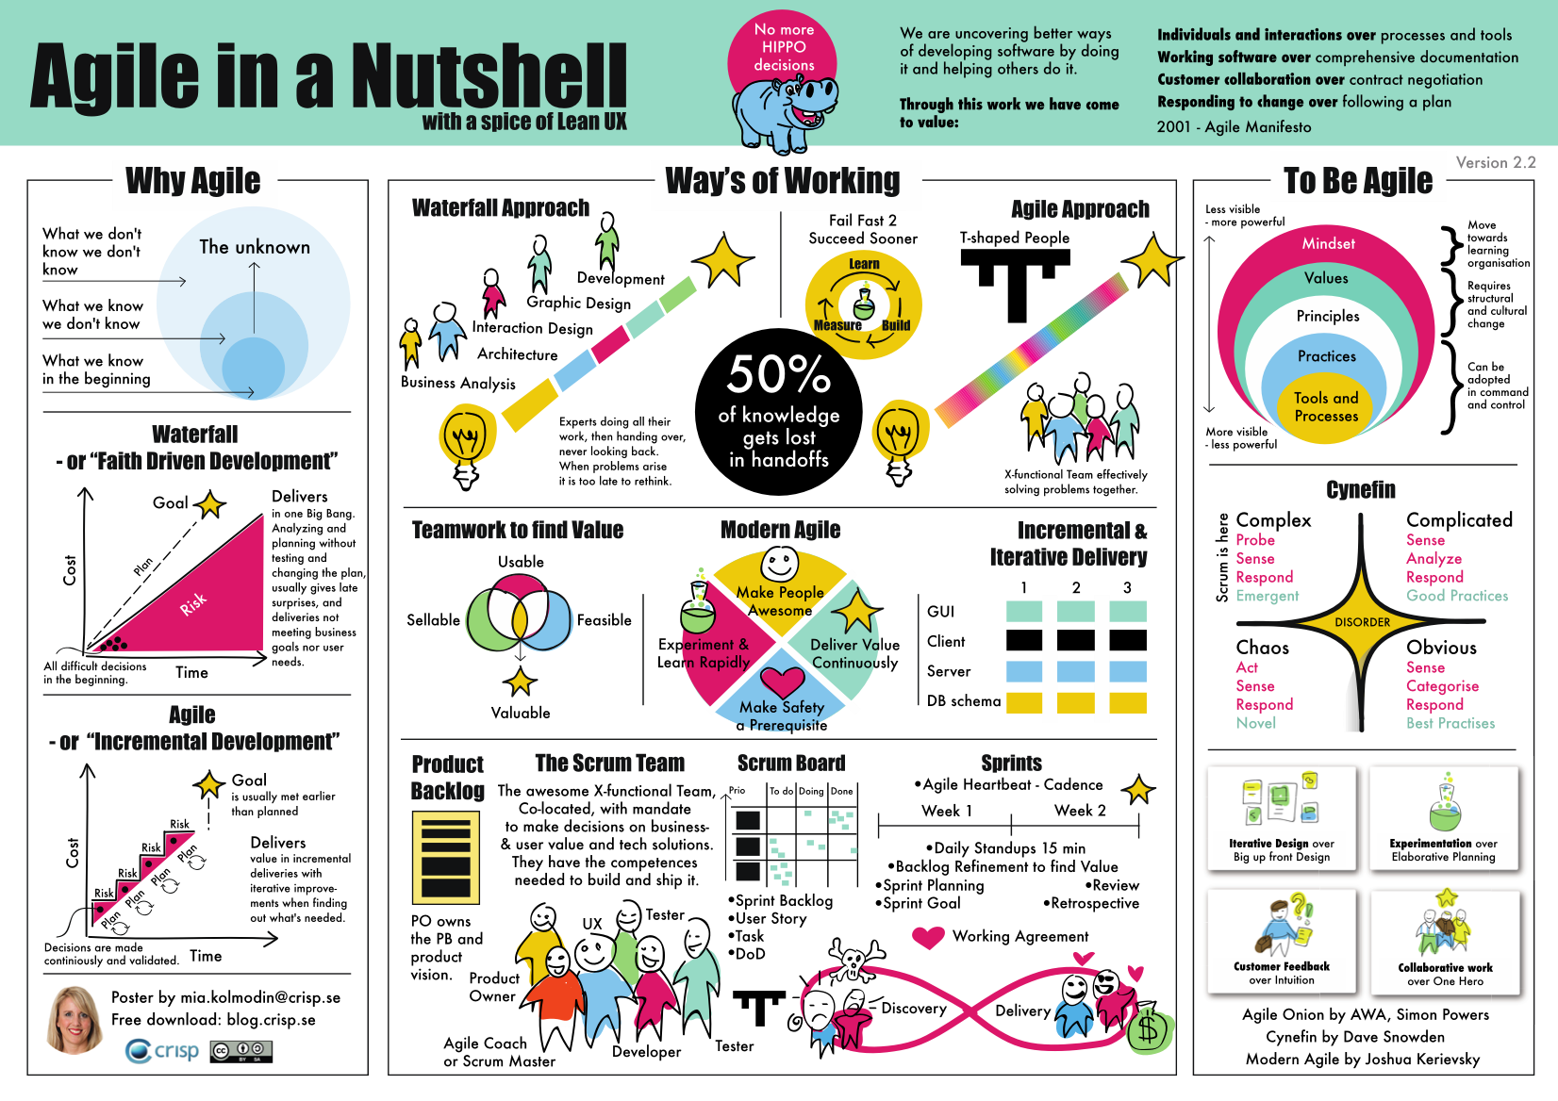

Slide 6
Agile software management: Scrum
Scrum is a framework implementing agile methodology.

Slide 7
Agile methods - in 49x
3 week sprints
Product backlog created in Kickoff kept in retrospective document
Sprint review - with supervisor (us via retrospective doc.)
Agile DOES NOT mean no documentation, you try to keep it to a minimum.

Slide 8
Kick-off document
Every reasonably complex project requires an initial planning.
In Kick-off document:
Description
Master feature list-> High level features, this will be your product backlog.
Workpackages -> High level planning, group the features present estimates on durations.
Overall systems architecture
More on template (Risk analysis, timeline, etc.)

Slide 9
Retrospective document
Sprint plan, backlog, product backlog
Sprint X summary (based on sprint X-1 retrospective)
Sprint X+1 plan
Overall progress on master features (backlog)
Details on template —> Read carefully/do not invent new labels/sections etc.

Slide 10
Retrospective document
https://docs.google.com/document/d/1gT-YlEKo9TcMft1q4mpgB6dM1S21T2zF1mDqUyahlPQ/edit?usp=sharing

Slide 11
Design overview document
Embracing the change (end of 491)
What we want to:
Document the software design (lightweight), from kickoff, present any changes
Clarify the problem being solved
Explain the reasoning behind the design decisions made
In your document:
Product description
High level system view
Overall design
Alternative design options

Slide 12
Final document
End of 492
Test plan. An overview of the tests performed throughout the year. Unit test, integration tests, user tests…
For each completed feature, explain how you verified it.

Slide 13
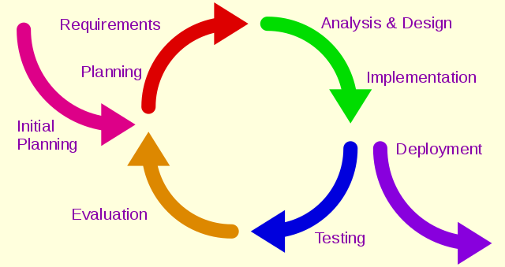
OVERVIEW
https://www.wikiwand.com/en/Iterative_and_incremental_development

Slide 14
OVERVIEW
TEST!!!
For fast development you need running code
https://www.wikiwand.com/en/Iterative_and_incremental_development

Slide 15

Unit tests!
Automate the testing process, always write your unit tests.

Slide 16

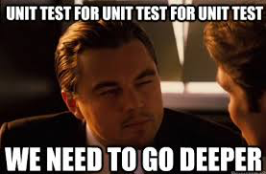
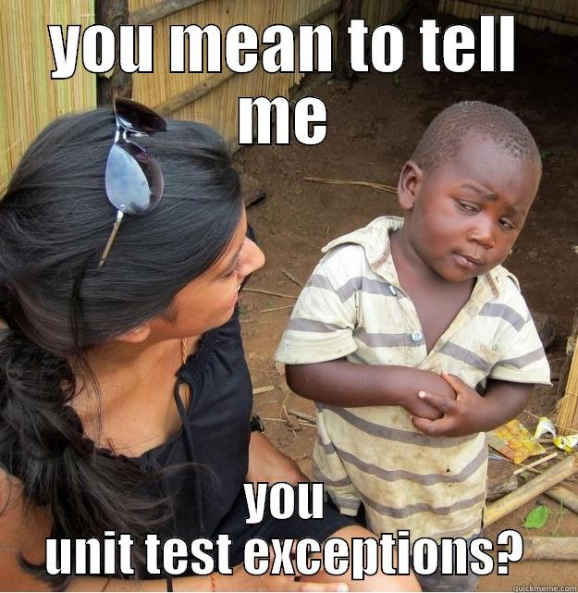
Unit tests!
Automate the testing process, always write your unit tests.

Slide 17

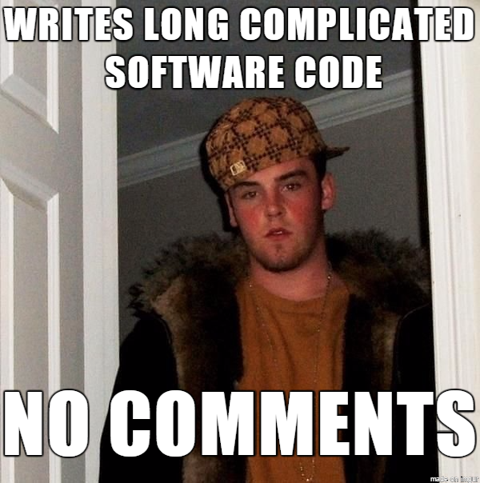
Readable code
Documents are always outdated, but the code is up-to-date -> make it readable (check code readability)
Unit tests improve readability

Slide 18
Questions?

